Slide 1
Do we matter (enough)?
Reflections on the significance of Public Administration
Paul ‘t Hart
Utrecht University
Netherlands School of Public Administration

Slide 2
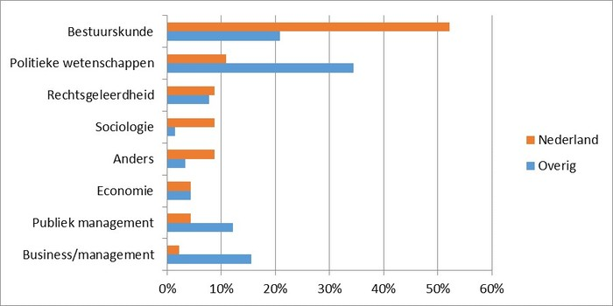
1. Who are ‘we’ ?
Who àre “we”, today?
Public
Adminis-tration
Political science
Public
Policy
Design science
Governance
Regulatory studies
Public Management
Economics
Sociology
Law / Legal studies
Anthropology
Planning
Leadership
Organization science
Conflict studies
Innovation science
History
Philosophy
ICT studies
Social Work
SST studies
HRM
Gadella et al., 2015
Notes:
A mono- and/or multidisciplinary (law, economics, pol sci, soc) and/or interdisciplinary field
Departments of PA and ‘governance of….’ sections/departments in other disciplines
PA – Public Policy – Public Management – Public Organizations – ‘Governance’
=>
It has rapidly become impossible to maintain a comprehensive overview let alone a fair assessment of significance of ALL THAT
Must also be daunting terrain to navigate for young scholars: what happens where is by no means evident, and there is less and less of a common intellectual core and professional identifcation

Slide 3
Significant where and for whom?
Academic arenas
Peer significance
Practical arenas
Practitioner significance
Public arenas Citizen significance

Slide 4
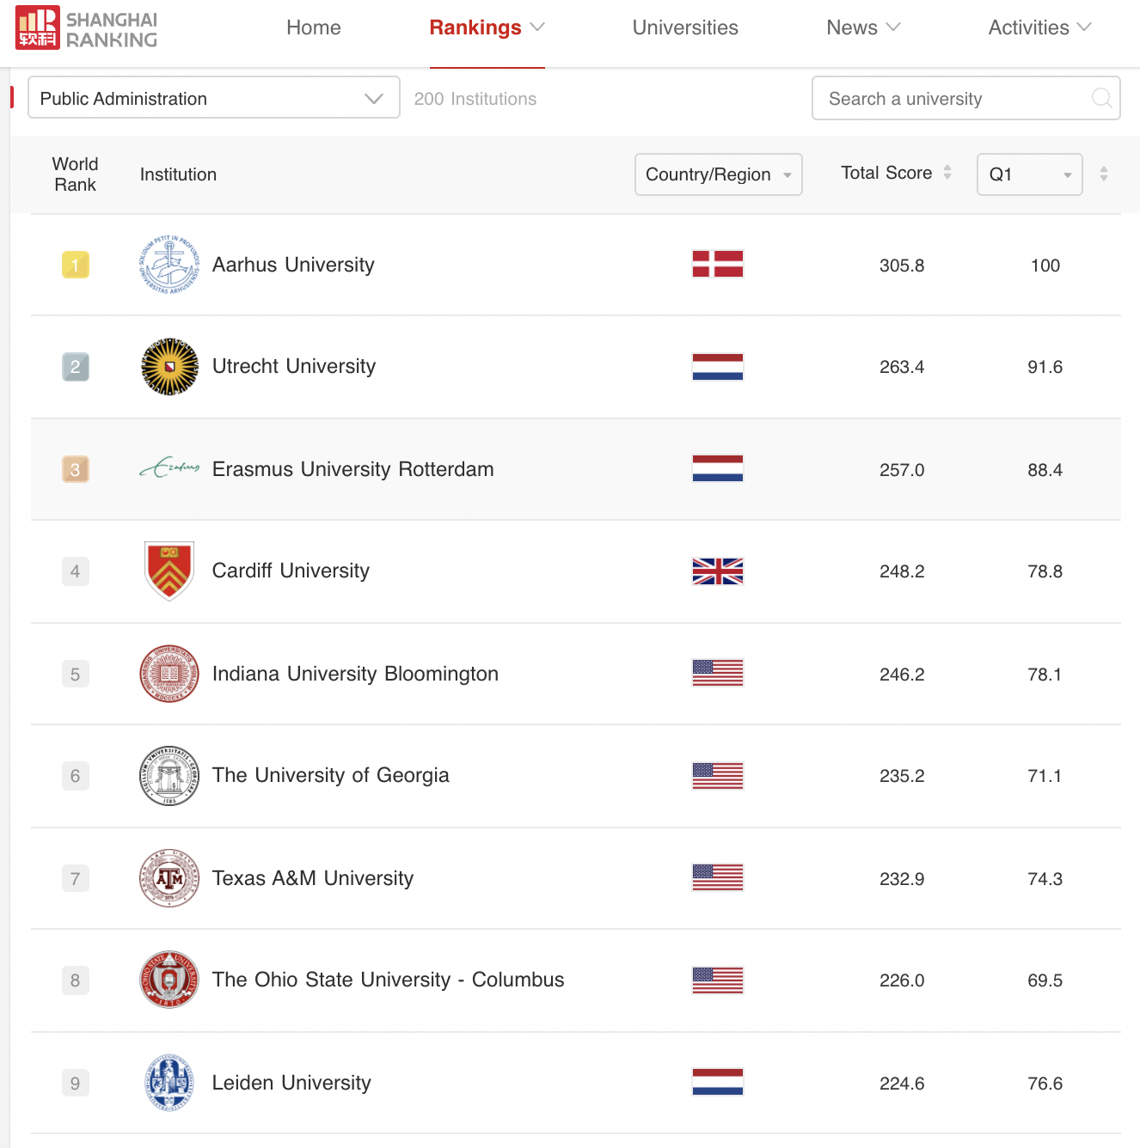
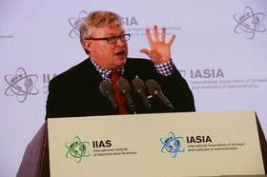
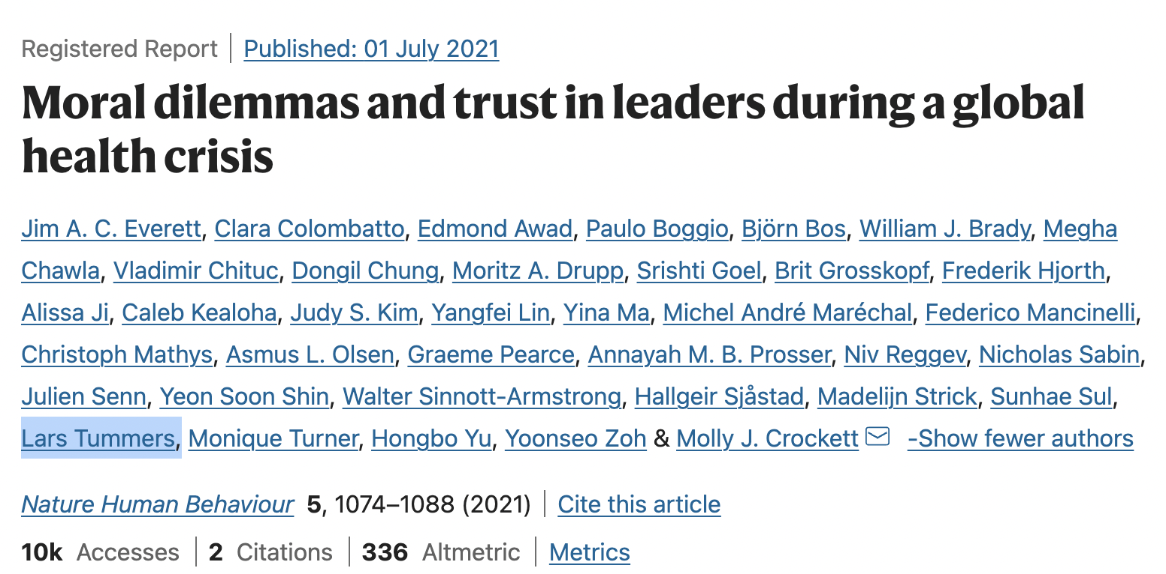
Academic significance
Our 2 PA’s in the national (NL/Be) academic landscapes
Our PA’s in the international PA (PP/PM/PO/Gov) landscape
PA in the broader international academic landscape
Notes:
Overal assessment:
In Dutch academic landscape: +. We have earned the grudgding (sociology, political science) and/or more generous (public law, public economics, planning, civil engineering, psychology,, anthropology, history) respect of our peers. Key indicators: size/spread of PA programmes/departments across tertiary institutions; student interest; NWO and other competitive grant income; membership of learned societies
In international PA landscape: ++. Dutch/Flemish PA no longer has the smell of Brussels sprouts about it. Key indicators: % of papers in top-15 journals; nr of books with high-impact int acad and textbook publishers; nr of core editorial positions; ERC and other competitive int grant income; honorary doctorates/awards from international bodies; hiring of Dutch/Flemish-trained phds/postdocs/faculty in other countries (incl professorships eg in UK, NZ, Germany)
In broader international ac landscape: fledgling/emerging. Key indicators: publications in high-impact journals in other disciplines (e.g. Science, Nature)

Slide 5
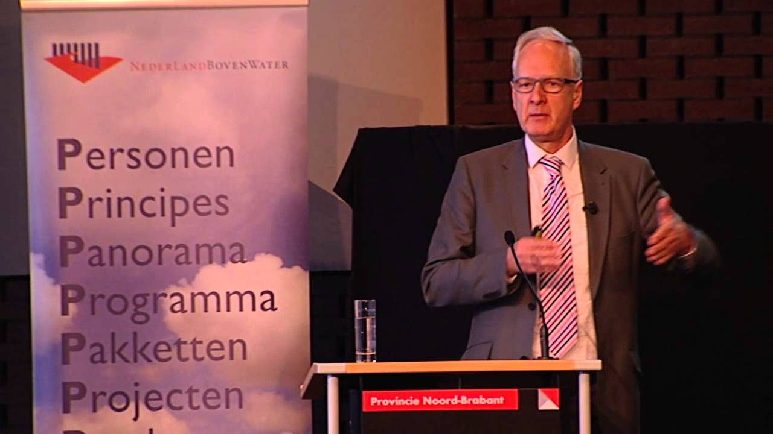
Significance to PA practice
Conceptual: language and lenses
Empirical:
facts, explanations, interpretations
Evaluative: criteria and assessments
Advisory:
counsel and critic
Exec ed:
‘tooling up’ and ‘opening up’
Crossing over: revolving-door mobility
Penetration Pecunia Positions Politics
Critic Jester Therapist Teacher Tool ….
Notes:
Overall assessment:
Strongest on: Conceptual (‘what sociology did in the 60s/70s, economics did in the 80s/90s; PA has done in the 00/10’s’) and in Exec ed.
Strong on: Empirical, Evaluative (quite sought-after/successful in competitive 3d stream applied-science funding, incl for phds and postdocs)
Selectively strong on: Advisory (membership of advisory committees, testimonies for parliamentry/council inquiries etc.)
Modest on: Crossing over / revolving door (cost of exiting from academia have risen as barriers for re-entry at level have become very high)
Counter-arguments - occasional/recurrent criticisms of Dutch PA’s practice orientation:
a. ‘Engineers/plumbers’ for bureaucrats – the technocratic fallacy
b. All too instrumental (what works) and process oriented – the managerialist fallacy
c. Too comfortable with the powers that be – the cheerleader fallacy (PtH as the ‘cuddly professor’).
d. Just fluffy talk and no scientific rigour – the imposter fallacy
e. You don’t really get what it’s like on the inside – the ivory tower / naivety fallacy

Slide 6
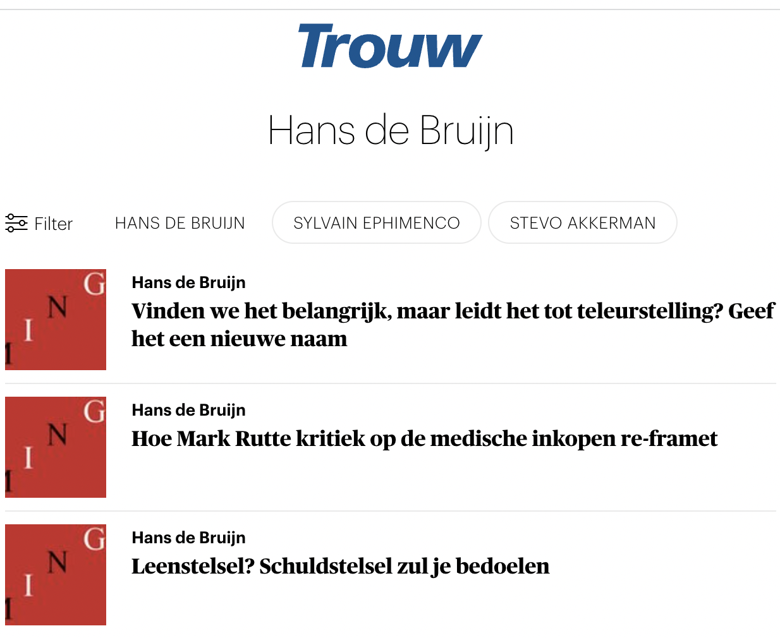
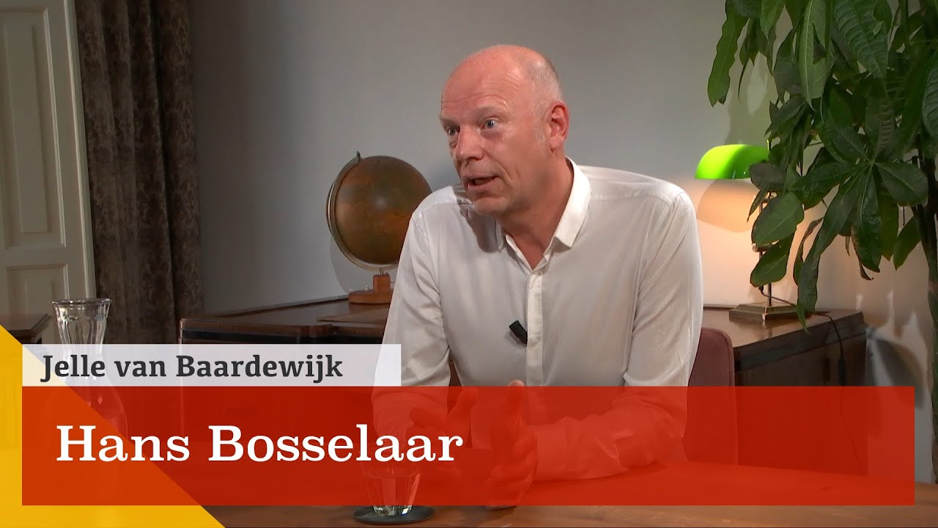
Public significance
Focus: the (governance of) big-ticket public issues/challenges of the era
Presence: in public forums/debates/media about public issues & society, politics & democracy, public administration & the public sector
Notes:
Re Focus: all too often painfully missing-in-action. PA has been really weak on social problems led perspectives and research agendas. We have been nearly completely absent in real-time public debates about big ticket items such as 9/11, social inequality, immigration/integration/multiculturalism, indebtedness, domestic violence, climate change, abortion/euthanasia. Often because we have neglected to study them. Sometimes because our nuanced ‘governance of’ messaging lacks the seks appeal to make it into the discursive mainstream.
Re Presence: ‘okay’ – but nowhere near to consistently following Matt Flinder’s triple-whammy impact strategy. For too many of us the ‘real work’ remains to ‘get into the journals’ (otherwise I don;t get respected/promoted). Hopefully the rise of E&W and the recalibration of hitherto dominant KPI systems will decisively change the incentive structures for young scholars

Slide 7
Can we matter (even) more? Advancing ‘impact’
Purposefully pick your subjects and questions
Be seen and heard in the right places at the right times
Impact has to be worked at
Impact is not a one-shot, rapid-fire game
Impact has to be equally noticed and and rewarded
Impact can generate (challenging) feedback
Never compromise your scientific integrity
Source: Wetenschap met de ramen wijd open: Tien lessen voor wie impact wil maken

Slide 8
Read more?
Christopher Pollitt, Shadowland : The Poorly-Mapped, Underdiscussed Yet Vital Interface Between Public Administration Research and Practice (2019)
Claire Dunlop, Bracing for impact: Is public administration ready to be relevant? (2019)
Khaldoun AbouAssi, Anna Amirkhanyan, Gloria Billingsley, Randolph Lyon, Reflections on the Persistent Issue of Relevance in Public Administration (2019)
Robert Jan van Putten, Lars Dorren, Willem Trommel, Kritische bestuurskunde: Naar een reflexief perspectief op bestuur en beleid (2020)
Koos vd Steenhoven et al, Meerwaarde van Bestuurskunde vanuit overheidsperspectief (2008)

